Slide 1
The art of Devising Thumnail Models
Kees van Overveld
for Marie Curie International PhD exchange Program

Slide 2
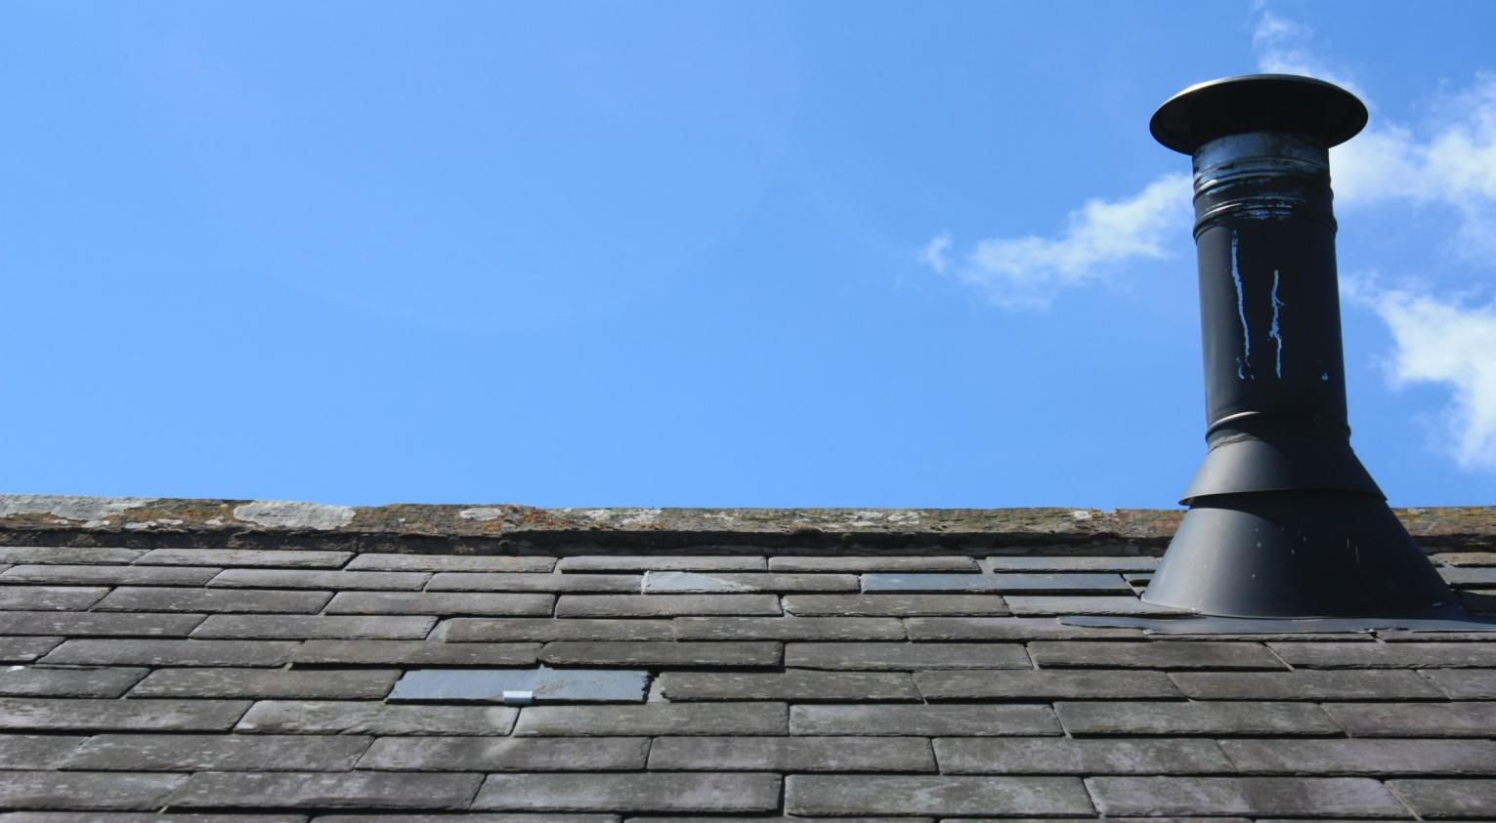
http://www.sxc.hu/photo/1361109
“How many chimney sweepers
work in Eindhoven?”
Notes:
2

Slide 3
relations
dimensions
assumptions
todo
nrChSwIE =
nrChIE * nrSwPCh
[Sw / E] =
[Ch / E] * [SW / Ch]
Eindhoven ch.-sweepers sweep Eindhoven chimneys only
nrChSwIE
nrChIE
nrSwPCh
nrChPFam
nrFamIE
nrPIE
nrPPFam
nrChIE =
nrChPFam * nrFamIE
[Ch / E] =
[Ch / Fam] * [Fam / E]
ch.-sweepers sweep only chimneys on family houses
nrFamIE =
nrPIE / nrPPFam
[Fam / E] =
[P / E] / [P / Fam]
nrPPFam is the same everywhere (does not depend on ‘Eindhoven’)
nrPIE = 250000 [P]
common knowledge
nrPPFam = 2.2 ± 0.2 [P/Fam]
public domain
nrChPFam (= 1/nrFamPCh) =0.1±0.02 [Ch/Fam]
wisdom of the crowds
Sw=sweeper; Ch=chimney;E=Eindhoven;Fam=Family;P=people;Se=Service;
Notes:
3

Slide 4
relations
dimensions
assumptions
todo
nrSwPSe * nrSePCh
relate sweeper’s capacity to chimney’s need
nrSwPCh =
[Sw / Ch] =
[Sw*year/Se] * [Se/(Ch*year)]
nrChSwIE
nrChIE
nrSwPCh
nrChPFam
nrFamIE
nrPIE
nrPPFam
nrSwPSe
nrSePCh
timeP1Se
timeP1Sw
nrSwPSe =
timeP1Se / timeP1Sw
[Sw * year / Se] =
[hour / Se] / [hour / (Sw*year)]
assume average times (i.e., no season influences etc.)
timeP1Se = 2±0.25 hour / Se
wisdom of the crowds
timeP1Sw = 1200±100 hour / Sw * year)
work year = 1600 hours
nrSePCh = 1 Se /( Ch * year)
insurance requirement
todo list is empty → model is ready
Sw=sweeper; Ch=chimney;E=Eindhoven;Fam=Family;P=people;Se=Service;
Notes:
4

Slide 5
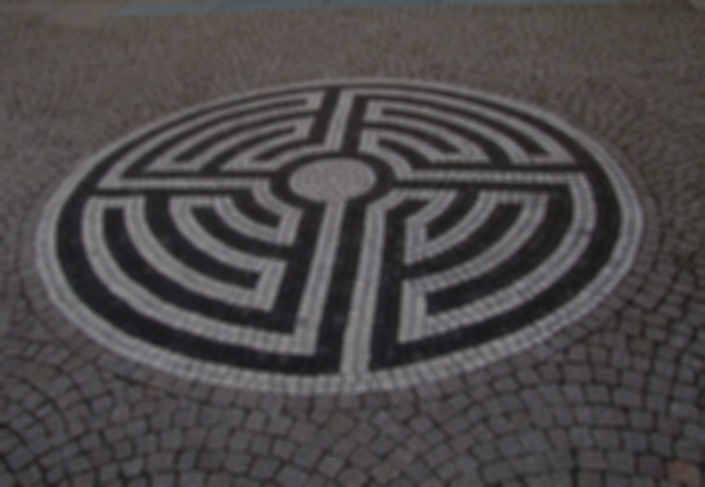
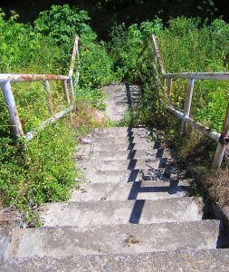
QUIZ
Why did we compute the number of chimney sweepers in Eindhoven?
http://www.sxc.hu/browse.phtml?f=download&id=587687
Notes:
5

Slide 6
Where does this lead to?
Nowhere
...since we formulated no purpose!
http://www.sxc.hu/browse.phtml?f=download&id=587687
Notes:
6

Slide 7
What purposes could we think of?
QUIZ
Give at least three different reasons why we could be interested in the number of chimney sweepers in Eindhoven?
Notes:
7
You may try to find examples for other purposes of the chimney sweepers model (think of analysing, predicting and unifying)

Slide 8
What purposes could we think of: e.g. verification
are there at least 300 Chimney Sweepers so that we can begin a professional journal?
so: we only need to know if NrChSwIE > 300
Notes:
8
You may try to find examples for other purposes of the chimney sweepers model (think of analysing, predicting and unifying)

Slide 9
What purposes could we think of: e.g. verification
are there less than 50 Chimney Sweepers so that we can have next year’s ChSw convention meeting in the Restaurant ‘the Swinging Sweeper?’
so: we only need to know if NrChSwIE <50
Notes:
9

Slide 10
What purposes could we think of: e.g. verification
are there about as many Chimney Sweepers as there are Sewer Cleaners so that we can form efficient ‘Chimney and Sewage Control and Service Units’?
so: we only need to know if NrChSwIE is between 20 and 30
Notes:
10

Slide 11
What purposes could we think of:
… each purpose
poses different challenges
allows different approximations
Notes:
11

Slide 12
How did the construction of the model go about?
quantities we are free to decide
quantities to help us expressing dependencies
a quantity we were interested in
Cat I:choice
quantities we guess (measure, look up, ...) from the problem context
Cat IV: intermediate
Cat II: objectives
Cat III: context
Notes:
12

Slide 13
Try it yourself: make a model for a good meal
what constitutes 'good'?
how is this expressed in terms of cat-II quantities?
what relations govern their values?
what if some quantities are not numbers?
a model for good meal
a model for good and a cheap meal
Notes:
13

Slide 14
Category-I quantities correspond to
free decisions / modifications / explorations / ….
Category-II quantities correspond to things you want as a result of these decisions
minimal price → don't eat
minimal cholesterol and minimal price: → don't eat
enough kCal → eat enough bread
minimal cholesterol and enough kCal: interesting
enough kCal and as cheap as possible: interesting
interesting cases involve >1 criterion
...but not the other way round
not very interesting
Notes:
14

Slide 15
Category-I quantities correspond to
free decisions / modifications / explorations / ….
Category-II quantities correspond to things you want as a result of these decisions
conclusion:
many optimization problems involve trade-offs
examples:
largest volume with smallest area
largest profit with smallest investment
largest ... with least ...
largest velocity with largest safety
largest ... with largest ... (and other combinations)
also cases with >2 criteria often occur.
http://www.morguefile.com/archive/display/93433
Notes:
15

Slide 16
Category-I quantities correspond to
free decisions / modifications / explorations / ….
Category-II quantities correspond to things you want as a result of these decisions
QUIZ
In order to wrap something efficiently, I seek for a shape with maximal volume and minimal area.
In what case could I want a shape with minimal volume and maximal area?
conclusion:
many optimization problems involve trade-offs
examples:
largest volume with smallest area
largest profit with smallest investment
largest ... with least ...
largest velocity with largest safety
largest ... with largest ... (and other combinations)
also cases with >3 criteria often occur.
http://www.morguefile.com/archive/display/93433
Notes:
16

Slide 17
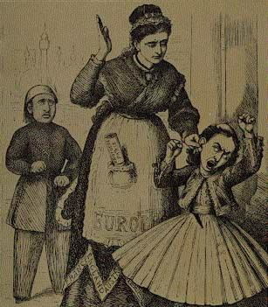
To express criteria, use penalties.
A penalty q = f(cat.-I quantities) is
a cat.-II quantity
a function of cat.-I quantities
≥0 (q=0 is ideal)
should be as small as possible
http://commons.wikimedia.org/wiki/File:Europe_punishes_the_spoilt_kid_(Greece)_for_asking_too_much.jpg
examples:
little cholesterol: q_{C}=|amountChol| = amountChol
enough kCal: q_{K}=|amountKCal - optimalAmountKCal|
Notes:
17

Slide 18
To express criteria, use penalties.
multiple criteria: multiple penalties
add: Q= Σ_{i} q_{i} ← only if q_{i} have same dimension
Q= Σ_{i} w_{i} q_{i ,} w_{i}>0← w_{i}q_{i} must have same dimension
weights w_{i}: values ???
if w_{i}’> w_{i}, then q_{i}’ will be smaller than q_{i}
Notes:
18

Slide 19
To express criteria, use penalties.
multiple criteria: multiple penalties
add: Q= Σ_{i} q_{i} ← only if q_{i} have same dimension
Q= Σ_{i} w_{i} q_{i ,} w_{i}>0← w_{i}q_{i} must have same dimension
weights w_{i}: values ???
multiple criteria by adding penalties: lumping
advantages:
works for arbitrarily many criteria
may use mathematical techniques
for a single Q = f(cat.-I)
(e.g., differentiate and require derivatives to be 0)
Notes:
19

Slide 20
To express criteria, use penalties.
multiple criteria: multiple penalties
add: Q= Σ_{i} q_{i} ← only if q_{i} have same dimension
Q= Σ_{i} w_{i} q_{i ,} w_{i}>0← w_{i}q_{i} must have same dimension
weights w_{i}: values ???
multiple criteria by adding penalties: lumping
disadvantages:
what should values for w_{i} be?
adding apples and oranges may be
ethically unwanted
Notes:
20

Slide 21
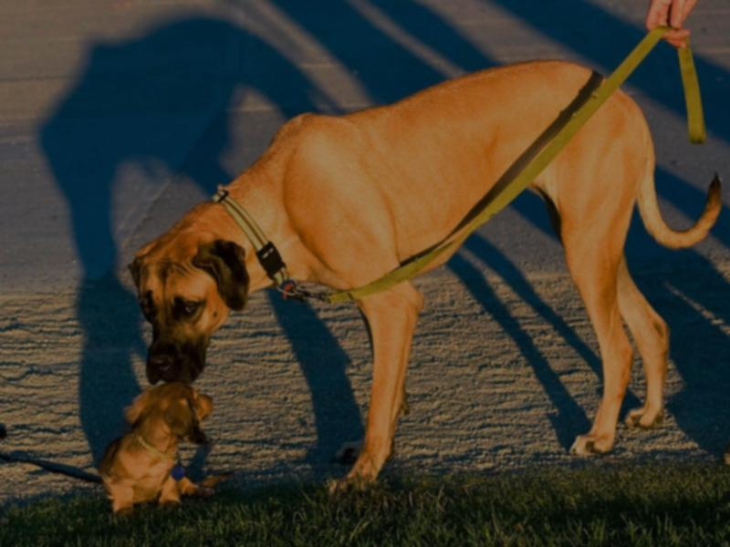
To express criteria, use penalties.
Variations to penalties (y = f(cat.-I quantities)):
q = y: y should be small; assume that y≥0
q = |y| or q=y²: y should be small in absolute value
http://commons.wikimedia.org/wiki/File:Big_and_small_dog.jpg
Notes:
21

Slide 22
To express criteria, use penalties.
Variations to penalties (y = f(cat.-I quantities)):
q = y: y should be small; assume that y≥0
q = |y| or q=y²: y should be small in absolute value
QUIZ
What penalty q could be used to express that y should be smaller than some y₀?
http://commons.wikimedia.org/wiki/File:Big_and_small_dog.jpg
Notes:
22

Slide 23
To express criteria, use penalties.
Variations to penalties (y = f(cat.-I quantities)):
q = y: y should be small; assume that y≥0
q = |y| or q=y²: y should be small in absolute value
q = |max(y,y₀)-y₀|: y should be smaller than y₀
q = |y₀-min(y,y₀)|: y should be larger than y₀
q = |y-y₀|: y should be close to y₀
q = 1/|y| or q = 1/(w+|y|), w>0: y should be large
et cetera (use function selector
or imagination!)
http://commons.wikimedia.org/wiki/File:Big_and_small_dog.jpg
Notes:
23

Slide 24
Cat.-II –space and dominance
Revisit optimization with multiple criteria:
Problems with lumping penalties Q=Σ_{i}w_{i}q_{i}
what are the values of w_{i} (trial and error)?
don’t add things that shouldn’t be added.
→ look for alternative approach, using dominance
Notes:
24

Slide 25
Cat.-II –space and dominance
Assume cat.-II quantities are ordinals:
Every axis in cat.-II space is ordered;
concept C₁ dominates C₂
iff, for all cat.-II quantities q_{i}, C₁.q_{i} is better than C₂.q_{i};
‘Being better’ may mean ‘<‘ (e.g., waste) or ‘>’ (e.g., profit);
http://www.morguefile.com/archive/display/765894
Notes:
25

Slide 26
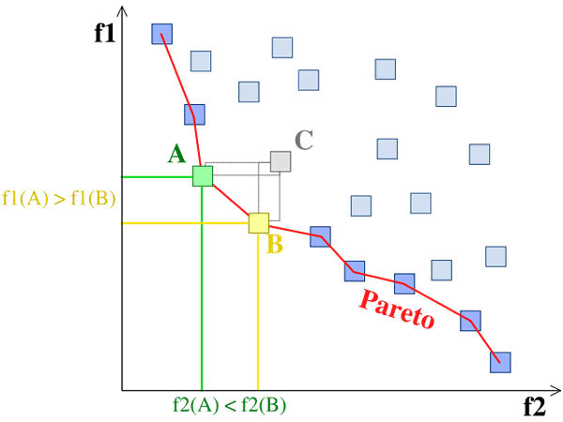
Cat.-II –space and dominance
A.f1<C.f1 and A.f2<C.f2, so
A dominates C
A.f2<B.f2 and B.f1<A.f1, so
B and A don’t dominate each other
f1 should be minimal (e.g., costs)
B.f1<C.f1 and B.f2<C.f2, so
B dominates C
f2 should be minimal (e.g., waste)
Notes:
26

Slide 27
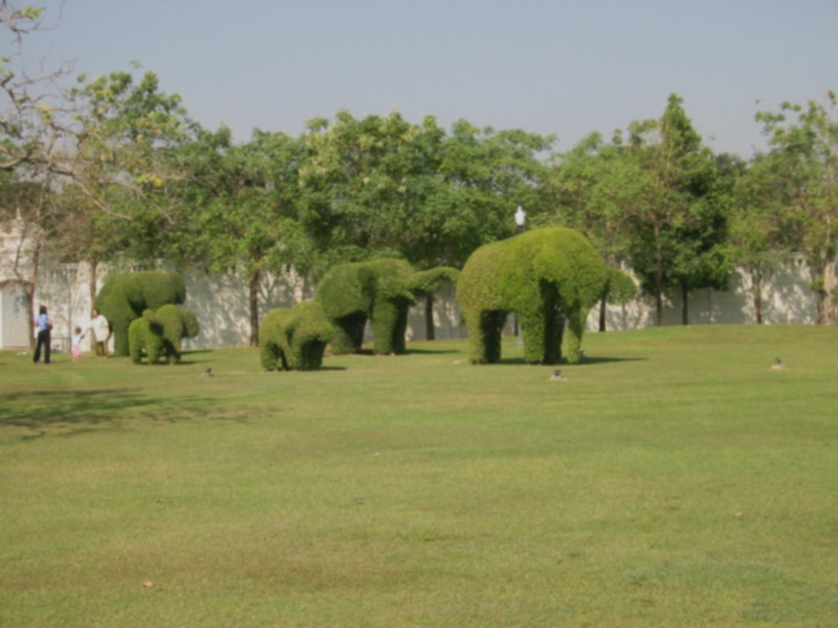
Cat.-II –space and dominance
Only non-dominated solutions are relevant → dominance allows pruning cat.-I space;
http://www.morguefile.com/archive/display/50363
Notes:
27

Slide 28
Cat.-II –space and dominance
Only non-dominated solutions are relevant → dominance allows pruning cat.-I space;
QUIZ
Why does cat.-I space needs to be pruned?
http://www.morguefile.com/archive/display/50363
Notes:
28

Slide 29
Cat.-II –space and dominance
Only non-dominated solutions are relevant → dominance allows pruning cat.-I space;
Nr. non-dominated solutions is smaller with more cat.-II quantities
http://www.morguefile.com/archive/display/50363
Notes:
29

Slide 30
Cat.-II –space and dominance
Only non-dominated solutions are relevant → dominance allows pruning cat.-I space;
Nr. non-dominated solutions is smaller with more cat.-II quantities
http://www.morguefile.com/archive/display/50363
QUIZ
Why do we have fewer non-dominated solutions with more cat.-II quantities?
Notes:
30

Slide 31
Cat.-II –space and dominance
Only non-dominated solutions are relevant → dominance allows pruning cat.-I space;
Nr. non-dominated solutions is smaller with more cat.-II quantities→ nr. of cat.-II quantities should be small (otherwise there are few dominated solutions).
http://www.morguefile.com/archive/display/50363
Notes:
31

Slide 32
Trade-offs and the Pareto front
In cat.-II space, dominated areas are half-infinite regions bounded by iso-coordinate lines/planes;
Solutions falling in one of these regions are dominated and can be ignored in cat.-I-space exploration;
Non-dominated solutions form the Pareto front.
Notes:
32

Slide 33
Trade-offs and the Pareto front
D
Cat.-II quantities f1 and f2 both need to be minimal. A and B are non-dominated, C is dominated. Of A and B, none dominates the other.
Notes:
33

Slide 34
Trade-offs and the Pareto front
D
Cat.-II quantities f1 and f2 both need to be minimal. Solution D would dominate all other solutions – if it would exist.
Notes:
34

Slide 35
Trade-offs and the Pareto front
Relevance of Pareto-front:
it bounds the achievable part of cat.-II space;
solutions not on the Pareto front can be discarded.
Notes:
35

Slide 36
Trade-offs and the Pareto front
Relevance of Pareto-front:
it exists for any model function, although in general it can only be approximated by sampling the collection of solutions.
Notes:
36

Slide 37
Trade-offs and the Pareto front
Relevance of Pareto-front:
it defines two directions in cat.-II space:
Notes:
37

Slide 38
Trade-offs and the Pareto front
direction of absolute improvement
http://cdn.morguefile.com/imageData/public/files/a/alvimann/preview/fldr_2010_03_23/file3831269347533.jpg
Relevance of Pareto-front:
it defines two directions in cat.-II space: the direction of absolute improvement / deterioration,
Notes:
38

Slide 39
Trade-offs and the Pareto front
direction of absolute deterioration
http://cdn.morguefile.com/imageData/public/files/a/alvimann/preview/fldr_2010_03_23/file3831269347533.jpg
Relevance of Pareto-front:
it defines two directions in cat.-II space: the direction of absolute improvement / deterioration,
Notes:
39

Slide 40
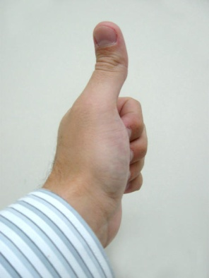
Trade-offs and the Pareto front
tangent to the pareto-front: trade-offs
http://cdn.morguefile.com/imageData/public/files/a/alvimann/preview/fldr_2010_03_23/file3831269347533.jpg
Relevance of Pareto-front:
it defines two directions in cat.-II space: the direction of absolute improvement / deterioration, and the plane perpendicular to this direction which is tangent to the Pareto front, which represents trade-offs between cat.-II quantities.
Notes:
40

